Slide 1


AGENDA
Ice Breaker
After-school Program Overview
Participant schedule & groups
Activities
Policies & procedures
Staff Expectations
Staff schedules
Refreshers
CPR/ First Aid Refresher
Safety refresher
Proper supervision
Conflict Resolution
Field trips
Enrichment
Wrap Up/ Reminders
#NYCisUS
www.universitysettlement.org

Slide 2

Welcome Back Team!!! Ice Breaker - Would you rather?
Would you rather have a phone with unlimited battery life or incredibly fast internet?
Would you rather be the smartest kid in a regular school or the average student at a prestigious school?
Would you rather have no social media followers but lots of real-life friends, or lots of social media followers but no real-life friends?
Would you rather have no social media followers but lots of real-life friends, or lots of social media followers but no real-life friends?​
Would you rather win the lottery or earn your wealth through hard work?
#NYCisUS
www.universitysettlement.org

Slide 3
Afterschool 2024-25
MONDAY | TUESDAY | WEDNESDAY | THURSDAY | FRIDAY
Arrival/Supper 2:40pm-3:00pm | Arrival/Supper 2:40pm-3:00pm | Arrival/Supper 2:40pm-3:00pm | Arrival/Supper 2:40pm-3:00pm | Arrival/Supper 2:40pm-3:00pm
Activity Block #1 3:00pm-4:30pm | Activity Block #1 3:00pm-4:30pm | Activity Block #1 3:00pm-4:30pm | Activity Block #1 3:00pm-4:30pm | Flag Football 3:00pm-4:30pm
Activity Block #2 3:00pm-4:30pm | Activity Block #2 3:00pm-4:30pm | Activity Block #2 3:00pm-4:30pm | Activity Block #2 3:00pm-4:30pm | Video Games 3:00pm-4:30pm
Activity Block #3 3:00pm-4:30pm | Activity Block #3 3:00pm-4:30pm | Activity Block #3 3:00pm-4:30pm | Activity Block #3 3:00pm-4:30pm | Movie Night 3:00pm-4:30pm
Activity Block #4 3:00pm-4:30pm | Activity Block #4 3:00pm-4:30pm | Activity Block #4 3:00pm-4:30pm | Activity Block #4 3:00pm-4:30pm | Creative Art 3:00pm-4:30pm
Enrichment Groups 4:30pm- 5:30pm | Enrichment Groups 4:30pm- 5:30pm | Enrichment Groups 4:30pm- 5:30pm | Enrichment Groups 4:30pm- 5:30pm | Open Gym 4:30pm-5:30pm
Dismissal 5:30pm-5:45pm | Dismissal 5:30pm-5:45pm | Dismissal 5:30pm-5:45pm | Dismissal 5:30pm-5:45pm | Dismissal 5:30pm
#NYCisUS
www.universitysettlement.org

Slide 4
Staff Schedules
STAFF | MONDAY | TUESDAY | WEDNESDAY | THURSDAY | FRIDAY
Jason Crowell (Program Director) | 10:00am-6:00pm | 10:00am-6:00pm | 10:00am-6:00pm | 10:00am-6:00pm | 10:00am-6:00pm
Kyara Rodriguez | 1:00pm-6:00pm | 1:00pm-6:00pm | 1:00pm-6:00pm | 1:00pm-6:00pm | 1:00pm-6:00pm
Aissatou Barry | 3:00pm-5:30pm | Day Off | 3:00pm-5:30pm | Day Off | Day Off
Jonathan Del Rio | Day Off | 3:00pm-5:30pm | Day Off | 3:00pm-5:30pm | Day Off
Joseph Maria | 2:15pm-5:45pm | 2:15pm-5:45pm | 2:15pm-5:45pm | 2:15pm-5:45pm | 1:30pm-6:00pm
Jeyda Pacheco | 2:15pm-5:45pm | 2:15pm-5:45pm | 2:15pm-5:45pm | 2:15pm-5:45pm | 1:30pm-6:00pm
Jayshawn Hernandez | 2:15pm-5:45pm | 2:15pm-5:45pm | 2:15pm-5:45pm | 2:15pm-5:45pm | 1:30pm-6:00pm
Jada Brown | Day Off | 2:15pm-5:45pm | 2:15pm-5:45pm | 2:15pm-5:45pm | 1:30pm-6:00pm
Lizbeiry Genao | 2:15pm-5:45pm | 2:15pm-5:45pm | 2:15pm-5:45pm | 2:15pm-5:45pm | 1:30pm-6:00pm
*Staff meeting will be on Fridays
#NYCisUS
www.universitysettlement.org

Slide 5
Fall School Year 2024-2025
Girls Volleyball – Student in the volleyball program will be focused on Leadership Development. We will collaborate East Side Girls Volleyball (Varsity) Team with Clinics and building relationships with other youth. | Ms. Barry | Schedule Everyday
Boys Basketball - Suitable for players of all skill levels, this program focuses on developing fundamental basketball skills, including dribbling, shooting, passing, and defensive techniques. Teams will be formed to MSAL sports teams. | Mr. Del Rio | Everyday
Dance - Open to participants of all skill levels. Students will have the opportunity to learn and perform choreographed routines, encouraging creativity and teamwork | Jada | Tuesday or Thursdays
#NYCisUS
www.universitysettlement.org

Slide 6
Fall School Year 2024-2025
Digital Art - Designed for all skill levels, this program introduces participants to various digital tools and techniques used in creating artwork on digital platforms. Activities include digital painting, graphic design, animation, and photo editing, among others. | Staff | Monday or Wednesday
Enrichment -Our Enrichment program aims to support well-rounded development, helping students discover new passions and build valuable skills for the future. This activity is perfect for those looking to expand their knowledge, try new things, and grow both academically and personally. Primary focus on School Curricilum and the Homework | All STAFF | Monday-Thursday
Career Exploration -Explorers program offers a unique and enriching experience for students eager to discover careers in New York City. Students will have the opportunity to visit iconic landmarks, explore museums, participate in outdoor adventures, and engage with the local community. Students can plan and implement their own Friday Trips to learn about different fields of study. | Lizbeiry | Once a month on Fridays
#NYCisUS
www.universitysettlement.org

Slide 7
S2024
Gaming - Our Gaming program aims to create a balanced and enriching environment where students have an engaging and educational experience centered around both video and tabletop games. | Jaydan
Soccer - Our Soccer activity for middle school students offers an exciting and comprehensive summer program designed to develop their skills, fitness, and love for the game. Our coaches emphasize teamwork, leadership, and good sportsmanship, ensuring a positive and supportive environment for all players. | Joseph | Mondays @ East Side
Flag Football - Open to participants of all skill levels, this program focuses on teaching the fundamental skills of volleyball, including serving, passing, setting, attacking, blocking, and defensive techniques. | Jayshawn | Fridays
#NYCisUS
www.universitysettlement.org

Slide 8

Afterschool Program Values
COMMUNITY - Embrace differences and come together as one to create a positive, nurturing space.
KINDNESS - Understand others by walking in their shoes.
INDEPENDENCE - Express yourself confidently and take responsibility for your choices and decisions.
ENERGY - Bring enthusiasm, spirit, and a positive attitude to every activity.
RESPECT - Treat others the way you would want to be treated.
CONFIDENCE - Believe you can achieve what you set your mind to.
#NYCisUS
www.universitysettlement.org

Slide 9
Arrival/Dismissal Procedures- Afternoon session
Participants must sign with a Group leader upon arrival in the cafeteria.
Participants must sign in by 2:50PM.
Participants must be signed out of the program by the Group Leader with Enrichment Sheet.
Participants can dismiss early with parental approval; a phone will be made by staff to a parent.
No Phone Policy in Afterschool Program.
Older youth, who allowed to self dismiss, must have prior consent from parent/guardian and they must sign out on the daily roster sheet.
Participants will only be released to the persons listed in their application. Any changes or additions must be made in writing.
For pick-ups, please have your photo ID with you at all times.
#NYCisUS
www.universitysettlement.org

Slide 10
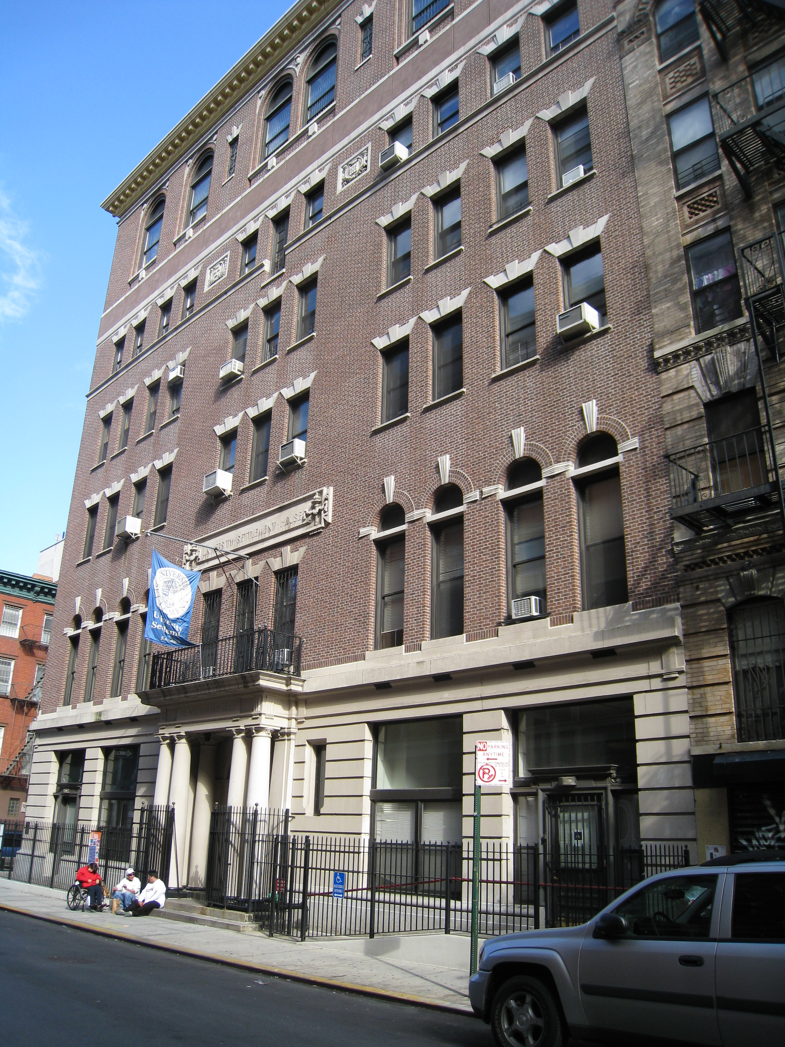
Behavior Policy
Participants must stay with their designated groups at all times
Before dismissal, students must receive parent permission to leave​ unless self-dismissed or parent notification
Participants must ALWAYS sign-out before leaving
Participants must be accompanied at ALL TIMES by a staff member​
Participants should never leave the building/playground unsupervised
Participants should be respectful towards each other, staff, & space at all times
No inappropriate language
Follow the rules and directions of staff
Do not damage property/space (tables, walls, posters, equipment)
NO PLAY-FIGHTING, TRASH-TALKING, NAME CALLING​
#NYCisUS
www.universitysettlement.org

Slide 11
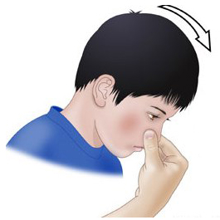
CPR/First Aid Refresher Training
Nose Bleeds
First-Aid Procedures?
STAY CALM!
Have child sit upright in a chair and have them tilt their head slightly forward
Have child gently pinch the soft part of their nose (just below bony ridge) with a CLEAN tissue/gauze
Apply pressure for 5-10 minutes
Wash up!
Create incident report/report to parents.
Call EMS if bleeding is excessive, lasts longer than 20 minutes, or student starts feeling faint/lightheaded.
What are the signs?
Bleeding from either nostril
Urge to swallow frequently
Sensation of liquid flowing in the back of the throat
#NYCisUS
www.universitysettlement.org

Slide 12

CPR/First Aid Refresher Training
Sprains
First-Aid Procedures? ​
STAY CALM! ​
Apply an ice-pack WRAPPED in cloth! (DO NOT apply to skin!)
Wrap a compression wrap around the affected area to limit movement (firmly, not tightly) https://www.youtube.com/watch?v=ReaLJfu7WS0
Create incident report/report to parents.
Child must rest for remainder of activity. Consistently check-in to observe any changes.
Call EMS if students report feeling numbness or sprain turns purple.
What are the signs?
Swelling of the impacted area
Bruising
Discoloration! (If it turns call EMS IMMEDIATELY!)
Pain/tenderness when moving the injured area
Warm to the touch
#NYCisUS
www.universitysettlement.org

Slide 13
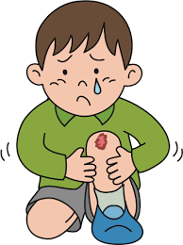
CPR/First Aid Refresher Training
Cuts/Scrapes
First-Aid Procedures? ​
STAY CALM! ​
Wear gloves before treating.
Rinse the wound/wash surrounding area with soap depending to remove debris/dirt.
Use an Antisepctic wipe to reduce infection.
Cover the wound (bandage, guaze, etc)
Create incident report/report to parents.
Call EMS if bleeding doesn't stop after applying pressure, is a deep cut that requires stiches, or participant goes into shock.
What are the signs?
Bleeding
Redness or swelling around the wound
Pain or irritation at the skin surface
#NYCisUS
www.universitysettlement.org

Slide 14
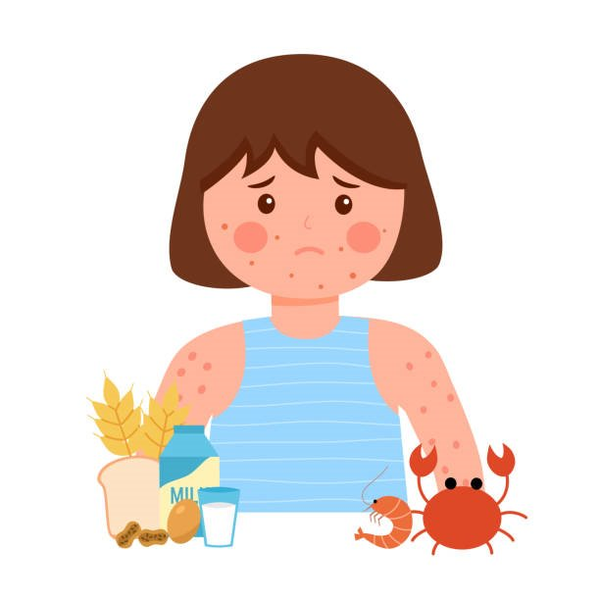
CPR/First Aid Refresher Training
Allergic Reactions
What are the signs?
Mild Symptoms
Itchy, slightly swollen skin
Sneezing, stuffy nose
Itchy, watery eyes
First-Aid Procedures? ​
STAY CALM! ​
CANNOT APPLY OTC medications
Call EMS if students exhibits signs of anaphylaxis.
Use student's PRESCRIBED inhaler or epinephrine pen.
https://www.youtube.com/watch?v=yqaLKuhMCPw
Create incident report/report to parents.
Severe Symptoms (Anaphylaxis shock)
Red bumps/hives
Trouble swallowing or speaking
Wheezing or belly pain, nausea
Dizziness or fainting
#NYCisUS
www.universitysettlement.org

Slide 15
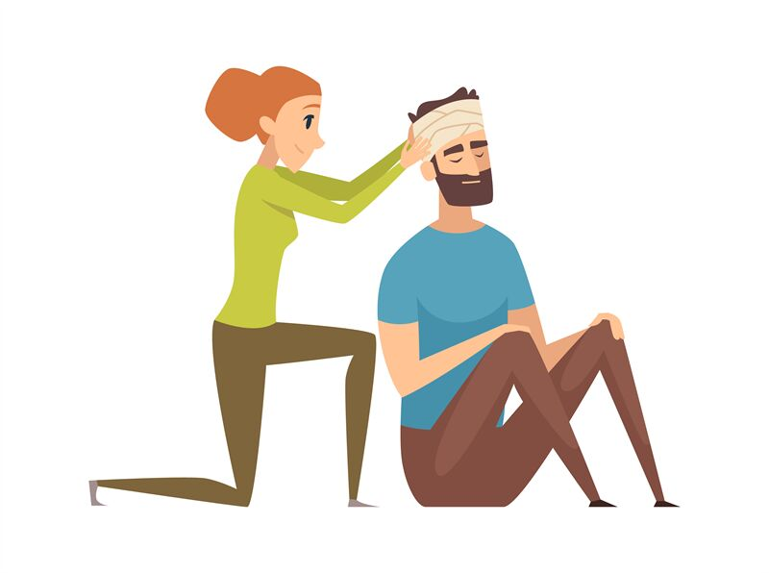
CPR/First Aid Refresher Training
Head Trauma
What are the signs?
Any Trauma to the scalp, skull or brain
External/internal bleeding.
Nausea/vomiting
Confusion/feeling lighthead headaches
Impaired vision/sensitivity to light
Stiff neck
Impaired speech (slurred, slowed down, incoherent)
First-Aid Procedures? ​
STAY CALM!
Have the student sit down, lay their head
Apply ice packs (covered) to the swollen areas​
On a 5-minute basis, check for any signs of concussions!
Create incident report/report to parents.
#NYCisUS
www.universitysettlement.org

Slide 16
CPR/First Aid Refresher Training
Head Trauma
When to Call EMS
Participant suffered serious neck injury/
Person is confused, tired or unconscious, stops breathing (if student is unconscious, perform high quality CPR)
There is severe head or face bleeding
DO NOTs!!
Do not move the person unless absolutely necessary
Do not shake the person
Do not wash any head wounds/remove any objects sticking out
Do not remove any helmets (can exacerbate any injuries)
#NYCisUS
www.universitysettlement.org

Slide 17
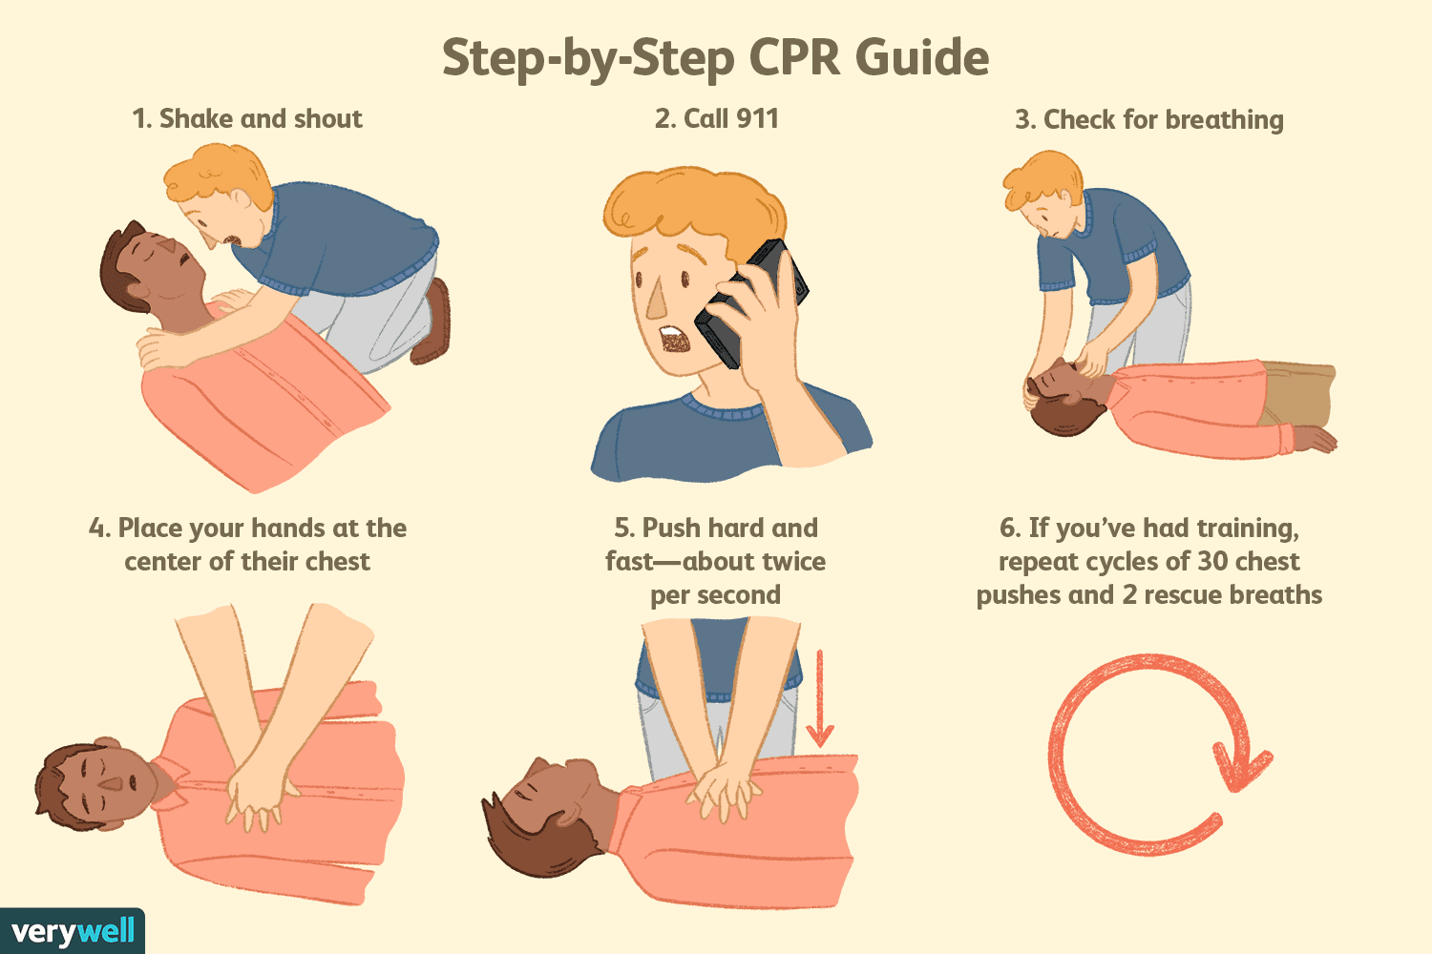
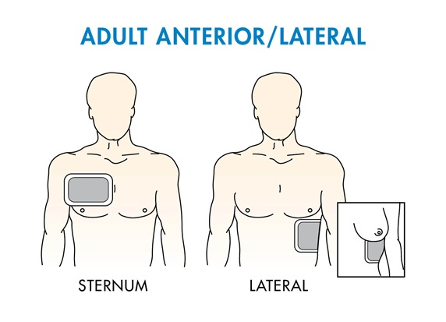
CPR/First Aid Refresher Training
CPR REFRESHER
ALWAYS ASK FOR HELP (2-3 man job)
One staff should call EMS/obtain AED and the other should begin performing high-quality CPR.
https://www.youtube.com/watch?v=6eRwgM2Pa4o
#NYCisUS
www.universitysettlement.org

Slide 18
CPR/First Aid Refresher Training
Incident Report/Scenarios
Instructions
Break out into groups of 2-3!
One staff will be the participant, another will be the GL
Devise your plan of action!
Create incident report (use today's date, your DOB, etc)
Read out scenario, Act out, perform first-aid (Take out any supplies you will need) and share incident report!
#NYCisUS
www.universitysettlement.org

Slide 19
Safety Refresher Training
Fire Drills Know where to exit and where to take participants Know your headcounts Leave belongings behind Keep participants quiet and orderly Have an Assembly Card Green = ☺ Red = >☹ Listen for the 'All Clear" | Soft Lockdown No imminent Danger/ Outside All interior and exterior doors are locked Movement inside the school is limited Education process may continue but with a heightened sense of awareness. Close all blinds to prevent anyone from being able to look inside Any outside activity is ended, and all students must report inside immediately. Staff should be prepared to quickly transition to Hard Lockdown if needed. | Hard Lockdown Imminent Danger Clear all hallways Stop all activities Lock and secure all doors Turn off lights Stay out of sight Use the RUN/HIDE/FIGHT strategy as necessary Wait for announcement and further instructions/first responders Those outside when a hard lockdown is called should use their best judgment whether to return to the school or evacuate to an offsite location
#NYCisUS
www.universitysettlement.org

Slide 20
Safety Refresher Training
Shelter-In Threat outside of the building Secure all exits Conduct business as usual, but do not leave the building Be more aware of your surroundings. Wait for further instructions. | Evacuation Listen to announcements Exit the building in an orderly fashion. Leave belongings behind. Evacuation site is same as fire drill, unless specifically directed to use a different location. HEADCOUNTS/ASSEMBLY CARDS! Report injuries, problems/missing students to supervisors. | Holds NO MOVEMENT UNTIL “All clear” is given. Business is conducted as usual. Hold might be initiated to manage an incident. NOT THE SAME AS A LOCKDOWN OR SHELTER IN
#NYCisUS
www.universitysettlement.org

Slide 21
Proper Supervision of Activities
Group Management Know head counts Make sure kids sign and the rosters are legible Make sure you always in ratio Participant are always in line of sight Participants are always escorted to/ from bathrooms or watched from the door. De-escalate any bullying, playfighting Avoid using your phone while supervising youth. | Positioning Staff should be positioned at the front of line or classroom Staff should spread out to cover exits in large spaces Staff should always face the direction of participants, even when speaking to others Staff should be leading the line and not the students. | Stay Alert Staff should not be on their cellphones or other devices when supervising group Communicate and coordinate with other staff to ensure safety Be alert, proactive, and engaged Make sure students are never left alone
#NYCisUS
www.universitysettlement.org

Slide 22
Conflict Resolution Tool and Strategies
Use Assertive Communication as an effective way of dealing with people. Assertive Communication: a person’s attempt to convey his/her needs or wants while considering the needs and wants of other people.
Addressing Conflict Issues Use “I” statements:
The first step in assertive communication is to use “I” statements. The difference between an “I” statement and a “you” statement is “I am feeling hurt.” Vs. “You are out of control”. “I” statements are designed to express and take responsibility for your feelings rather than blaming others.
There are four steps to developing an “I” statement. The focus is on the action or the circumstance you want changed, not on the person.
First, tell the person, “I have a problem”. This way you take ownership if the problem without placing blame on the other person(s).
Secondly, make a non-threatening description of the problem. It is critical that while describing the problem or behavior that you remain calm and collected.
Third, tell the person how you feel about the problem. This serves to make the problem more personal to you and the other person(s) involved.
Finally, let reality be the disciplining agent by asking these questions: If you continue the behavior, will it make our relationship better or worse? Do you want our relationship to get better or worse?
#NYCisUS
www.universitysettlement.org

Slide 23
Conflict Resolution Tool and Strategies
For Example:
1. “I have a problem.”
2. “I have noticed that you argue with people when they ask you to quit (the problem behavior).”
3. “It makes me feel bad when you do this because if you continue to act in this manner (the problem behavior), I must warn you, you won’t be able to continue to participate.”
4. If you continue (the problem behavior), will it make our relationship better or worse? Do you want our relationship to get better or worse?”
Take the time you need.
Removing yourself, either mentally or physically, in order to feel safe, secure, and/or in control. It can be necessary at times to slow down the process of becoming angry. This can be done by physically moving to a safe place or mentally by changing your focus. The goal is to avoid escalating the situation.
#NYCisUS
www.universitysettlement.org

Slide 24
Conflict Resolution Tool and Strategies
Take the time you need (personal)
1. Start by using “I” statements.
2. State your position. (“I really think this situation is this worth this much anger.”)
3. Indicate that you will be gone (). (“I am feeling too angry to talk about this right now.”) do not ask for permission
4. State a definite time you will return. (“I need 10 minutes to cool off right now.”)
5. Promise to work out the matter when you do return. (“When I get back, we can sit down and talk about it.”)
Don’t:
1. Blame others
2. Storm away
3. Debate the matter at that time
4. Order others to do something
Finding Resolution Resolution is a willingness to resolve the situation while maintaining respect for yourself and others. There are two places resolution can occur:
-Within yourself. The purpose of resolution is to deal with those first feelings while maintaining respect for all parties. Sometimes this may include solving the issue only with you.
-With others. In this case, it is important to use “I” statements and identify the first feelings to the other person. The important point to remember is to do so while keeping respect for all parties. Also, realize that the other parties may not accept your viewpoint.
*WSU/Walla Walla County 4-H*
#NYCisUS
www.universitysettlement.org

Slide 25
W.O.W. - A Conflict Resolution Tool
What's Up? | What happened? | Each participant gets a chance to share their vision of the conflict. Try to clarify both the facts of what occurred, and the feeling of the individual involved.
Own Up! | What could you have done differently? | Give each individual a turn so share how they contributed to the conflict.
What Now? | What is our plan for avoiding this conflict in the future? What will happen the next time a conflict like this occurs | Brainstorm solutions and future consequences. It may be helpful to capture this part of the conversation in writing (Behavior Tracker). Make sure the plan is a realistic solution.
Keep in mind:
If the plan doesn't work, make another;
You can always stop the process if the participants are not following the rules;
You can always say, "you're not ready for this conversation" if they are not ready to fully participant;
This approach can be used for groups or teams.
*WSU/Walla Walla County 4-H*
#NYCisUS
www.universitysettlement.org

Slide 26
Classroom Management
Effective Classroom Management is:
1. Planned not improvisational
2. Preventative rather than simply reactive
3. Controlled and organized rather than chaotic
4. An opportunity for all students and teachers to experience success
Tips for Arranging the Classroom
Have extra supplies available at a location in the classroom where students who have forgotten supplies will be able to go without disrupting other students (i.e. a cup of pencils at the center of each table or the back of the classroom).
Set a good example to your students by providing a neat and organized classroom.
Make your classroom look attractive. Use plants, bulletin boards, banners, warm colors, or anything to help make your classroom look aesthetically pleasing.
Structure your classroom as to avoid chaos and promote learning. For instance, do not place a talkative student next to the pencil sharpener because this creates many opportunities for disruptive behavior.
The teacher should be able to observe all students at all times and be able to see the door from his/her desk.
Students should be able to see the teacher/presentation area without having to move or turn around.
Arrange the room as to allow easy movement.
Main idea: Make your classroom fun, attractive, motivating, & functional.
#NYCisUS
www.universitysettlement.org

Slide 27
Classroom Management
Effective Classroom Management is:
1. Planned not improvisational
2. Preventative rather than simply reactive
3. Controlled and organized rather than chaotic
4. An opportunity for all students and teachers to experience success
Tips for Arranging the Classroom
Have extra supplies available at a location in the classroom where students who have forgotten supplies will be able to go without disrupting other students (i.e. a cup of pencils at the center of each table or the back of the classroom).
Set a good example to your students by providing a neat and organized classroom.
Make your classroom look attractive. Use plants, bulletin boards, banners, warm colors, or anything to help make your classroom look aesthetically pleasing.
Structure your classroom as to avoid chaos and promote learning. For instance, do not place a talkative student next to the pencil sharpener because this creates many opportunities for disruptive behavior.
The teacher should be able to observe all students at all times and be able to see the door from his/her desk.
Students should be able to see the teacher/presentation area without having to move or turn around.
Arrange the room as to allow easy movement.
Main idea: Make your classroom fun, attractive, motivating, & functional.
#NYCisUS
www.universitysettlement.org

Slide 28
Classroom Management
Tips for Creating a Positive Classroom Environment
1. Use humor.
2. Greet students at the doorway and in the halls.
3. Show enthusiasm and be animated.
4. Provide opportunities for every student to succeed.
5. Model good listening skills by paying attention when student speak.
6. Create anticipation for lessons or tasks.
7. If a particular student is struggling, provide the student with a classroom buddy who is mature and responsible.
8. Create classroom rituals and traditions which build a sense of community.
9. Encourage parental and community involvement.
Tips for Preventing Misbehavior
Establish realistic and age appropriate rules and procedures. Center for the Advancement of Mental Health Practices in Schools
Have discussions with your students about the rationale and purpose of each rule. When appropriate, incorporate student opinions and thoughts into your classroom rules and procedures.
Walk throughout the classroom during lectures and seat work to provide assistance and monitor behavior.
Keep class work and assignments separate from behavior issues.
Carefully plan each class time and have extra plans in case you finish early.
Have extra activities available for students to do when they are bored or finished with all their work.
Establish routines for transitions (leaving the room, using the bathroom, etc.) and prepare students for transitions by warning them ahead of time
#NYCisUS
www.universitysettlement.org

Slide 29
Classroom Management
Tips for Preventing Misbehavior (Continued.)
8. Reinforce and praise appropriate behavior.
9. When deciding whether or not to intervene with a behavior, determine if the problem is solely “teacher-owned.” Does the behavior simply annoy you or is it harmful to other students?
10. Establish a program that teaches self-discipline and responsibility to students. When appropriate, give students extra duties that will help save you time and teach them responsibility.
Tips for handling student discipline situations
1. REMAIN CALM AND COMPOSED!
2. When correcting misbehavior, communicate in the most private, respectful, and positive manner.
3. Make all discipline decisions after the “heat of the moment.”
4. Use appropriate humor to de-escalate conflict situations.
5. When you feel as if you or your student is too emotional to handle a particular situation, suggest postponing the discussion until both are prepared to talk it out.
6. Instead of blaming, use I-messages to explain why the behavior was disruptive. Instead of saying “You’re disruptive” try saying “I lose my concentration when you are talking in class.” This helps to avoid an angry retaliation.
7. Use positive self-talk to reduce stress and help to remain control. Mentally say things such as “remain calm,” “I’m doing a good job at handling this situation.”
8. Attempt to de-escalate situation by providing distractions. These distractions give people the opportunity to cool off.
9. Exaggerate issues to help students put the situation in perspective.
10. Use stress management techniques such as deep breathing or repeatedly tensing and relaxing your muscles.
11. Address only student behavior rather than personal traits.
#NYCisUS
www.universitysettlement.org

Slide 30
FIELD TRIPS
Before We Leave/Return Know the destination Review the travel route with kids Review "lost kid" procedures Instruct kids to put electronics away Count your kids before leaving the building | While Walking There should be no phones, headphones, or electronics out Make sure one adult is the line leader, other staff walk along side their groups on the side nearest the street, and one staff is in the back of the line. Students do not pass the first adult or lag behind the last. Cross in crosswalks using signals. Never cross the street on red signal Staff in the middle of the line will block off any potential oncoming traffic, while the other two group leaders at the beginning and end of the line, walk the group across the street. Be considerate to pedestrians Block any basement openings | While in the Station Count your kids when you get to station Students should stay near the staff and make sure you can see them, and they can see you. Stand 2-3 feet away from the platform Be alert If anything feels unsafe or anyone is bothering a student, THEY SHOULD NOT ENGAGE. No phones or electronics out, and no headphones in. Staff should travel in the same train car and direct students to a specific car as the train slows down at the station. Staff must hold doors until all students have entered or exited the train.
#NYCisUS
www.universitysettlement.org

Slide 31
FIELD TRIPS FOR STAFF
While on the Train Count your kids when you get on the train Students should stay in the train car with staff and stay visible Stay alert-Staff & kids Be mindful of the other passengers on the train DO NOT ENGAGE with anyone you do not know Move kids away from anyone who makes them feel unsafe Count your kids when you get off the train | Lost Child Participants If they are left at the station: wait at the station near the booth or a police office. If they are left on the train: they should get off at the next station and wait near the booth. Staff Communicate situation to Director/Assistant Dir immediately Get coverage for your group Get off at the next station and travel back Call child parents Incident report | Bus trips Count your kids before leaving the building Know what bus you're assigned to before leaving the building Put away electronics until on the bus Count your kids when the seated on the bus Have plan for how your group will spend time at the venue (i.e. what rides you're going on) Know what bus number you're on Know what time to be back on the bus Count your kids when you are back on the bus
#NYCisUS
www.universitysettlement.org

Slide 32



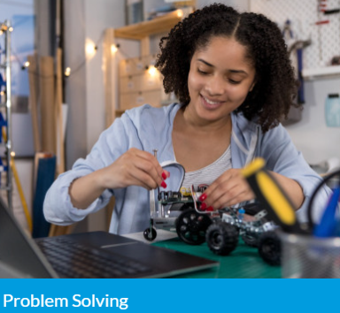
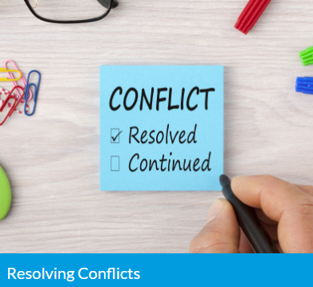
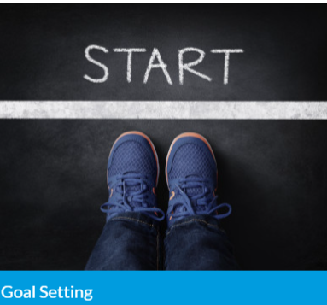
ENRICHMENT LESSON PLANNING
Cheat code: www.overcomingobstacles.org
#NYCisUS
www.universitysettlement.org

Slide 33
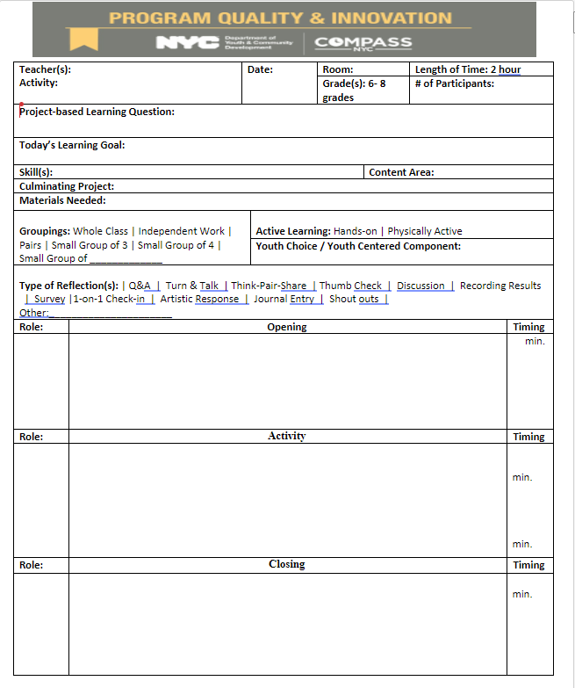
ENRICHMENT- Lesson Planning
Enrichment block will have dedicated topics to cover:
- Mondays (Game-based/Group Themes)
-Tuesdays (Vocabulary Themed)
- Wednesdays (Arts, Culture, STEM Themed)
-Thursdays (Staff Choice for the theme)
Week#1: Getting Started - Ice Breaker Games + HW
Examples:
Monday – Absurd Trolley Problems
Tuesday: Spelling Bee / Boggle / Wordle / Pictionary
Wednesday: Who am I? Art based lesson
Thursday: Mafia/ Murder Mystery Game
You are also able to use lesson plans that are approved by admin staff that you would like to use.
Must be submitted weekly before Friday Meetings.
#NYCisUS
www.universitysettlement.org

Slide 34
Wrap Up/ Reminders
Please make sure you catch up on NINJIO Trainings via University Settlement Email
Make Sure timesheets are completed on time
Lesson plans need to be completed at least 1 week in advance and approved by the program director.
#NYCisUS
www.universitysettlement.org

